Slide 1

Arduino Based Motor Control
event: Hack Night
date: 10-22-14

Slide 2
Last Time
Learned to set up and write simple code on Arduino Nano
Defined pins as OUTPUT
Used “digitalWrite(pin, state)”

Slide 3
Today
Learn…
Basic motor types
Driver and control methods
How to protect your microcontroller
DO IT!

Slide 4
Motor Types (Actuators)
Brushed DC Motor
Stepper Motor
Brushless DC Motor
Solenoid
RC Servo

Slide 5
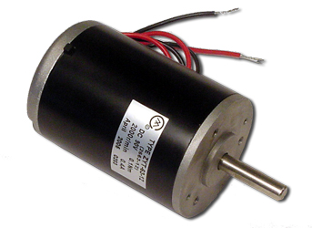
Brushed DC Motor
We’ll cover the dirty details later in this presentation
Two wires, mechanical
switching of brush contacts
Cheap, easy, and common

Slide 6
Stepper Motor
Discrete incremental “steps”
Many different setups
Common is 4 wire, 2 coil

Slide 7
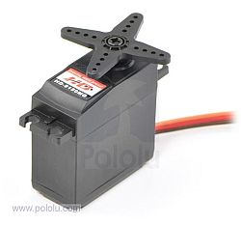
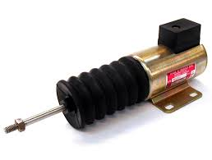
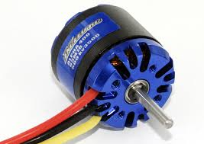
Other Motors
Solenoid
RC Servo
Brushless

Slide 8
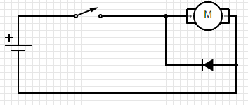
Control of DC Motor
Simple Switch

Slide 9
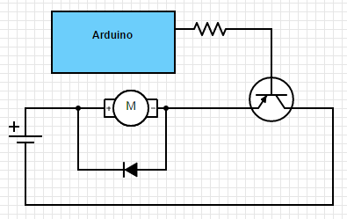
Control From Arduino
First use “pinMode(pin, OUTPUT)”
Use “digitalWrite(pin,HIGH)”
HIGH = ON
LOW = OFF
What about speed?

Slide 10
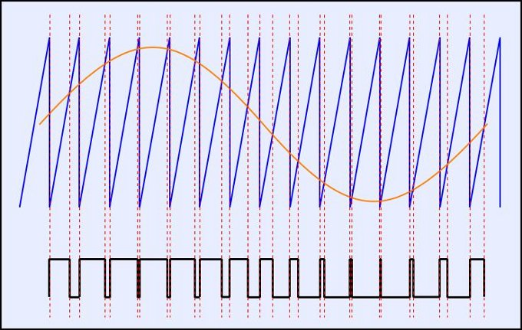
PWM (Pulse Width Modulation)
Control motor speed with PWM
Use “analogWrite(pin,value)”
Value (0 – 255)
What about
different directions?

Slide 11
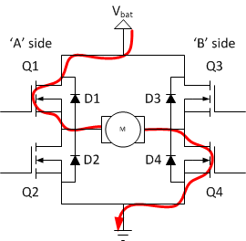
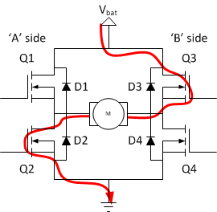
H- BRIDGE
Bi-directional Control
Two distinct current paths
Four switch states to control
Often implemented using IC

